Slide 1
DPW Feasibility Committee
Capital Budget Committee Presentation
February 11, 2021
Rick McGuire

Slide 2
Contents
Committee Background
Committee Approach and Methodology
Architectural Recommendation
Implementation Plan
Next Steps and Committee Recommendations
Benchmark Comparisons

Slide 3
Committee Members
Andy Leonard
David O'Brien
Dan Lazarz
Rick McGuire – Chairman
Jonathan Moen
Peter Castanino*
Bill Montonegro*
*Former Members

Slide 4
Committee Approach and Methodology
Reviewed previous study
Reviewed and analyzed Weston & Sampson engineering report and recommendations
Meetings with consulting engineer (Jeff Alberti - Weston and Sampson)
Evaluated needs and critical components for new DPW Facility
Toured existing facility
Interviewed key officials including: Dennis Westgate (DPW Director), Kelly McElreath (Assistant to Town Manager) and John Johnson (Highway Supervisor)
Mike Marchand (DPW committee member) participated in a number of planning meetings
Facilitated workshop to discuss initial concept, review building program and space plan, verify programs and regulatory requirements
Establish priorities for a DPW facility
Conducted a Value Engineering Workshop to determine priorities and top level requirements
Tasked consultant to revise design and incorporate project phasing
Recommended plan to fulfill the Town’s needs

Slide 5
DPW Committee Architectural Recommendation*
Committee recommends a two (2) phased approach to meet town financial needs
Architecture #3 - Linear building layout with expansion capability
Two (2) phase approach avoids $600K to $1 M in overall cost
Phase 1 Implementation Approach
Addresses top priority goals – employee safety, regulatory compliance, and department effectiveness
Delivers a 20,000 SF building with 8,500 SF of building and equipment storage – an increase of 6% over existing storage space
Contains administrative and employee support, workshops, vehicle maintenance, wash bays, and vehicle storage in one building
Upon Phase 2 completion, total vehicle/equipment storage area of 15,800 SF increases vehicle storage space by 98% over existing
Reuse existing building of 9,000 SF and 19,700 SF of new construction for a total building area of 28,700 SF at Phase 2 completion
*Central fueling facility project slated for consideration at a later date

Slide 6
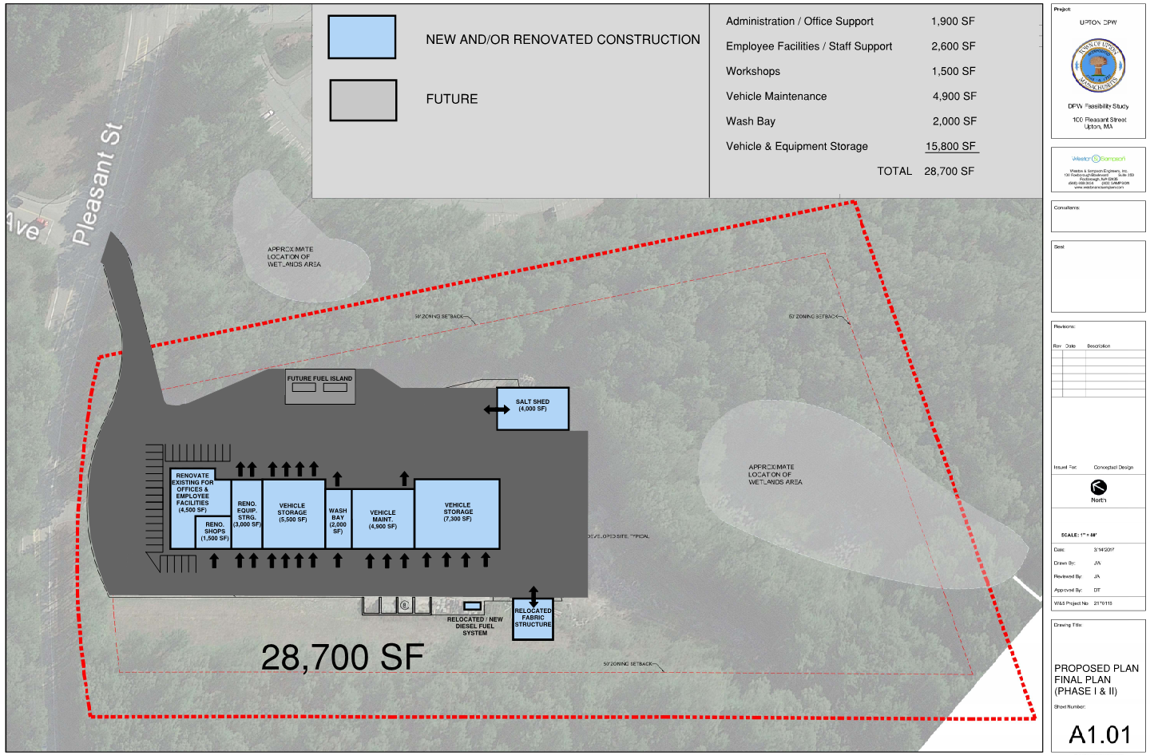
Architecture #3 DPW Facility

Slide 7
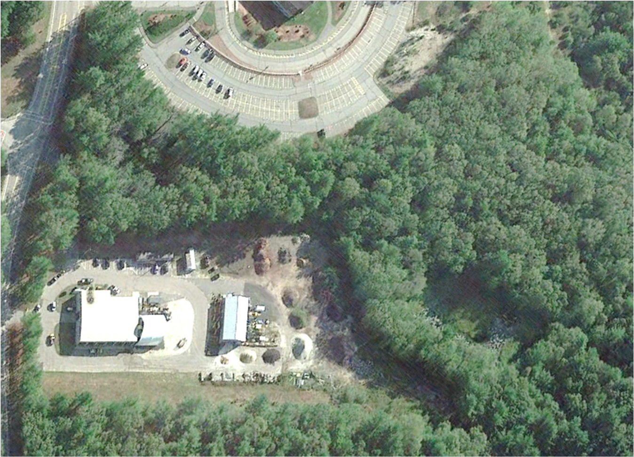
Current Facility (Aerial View)
Office
Employee Facilities Shops
Vehicle Maintenance Wash Bay
Vehicle Storage

Slide 8
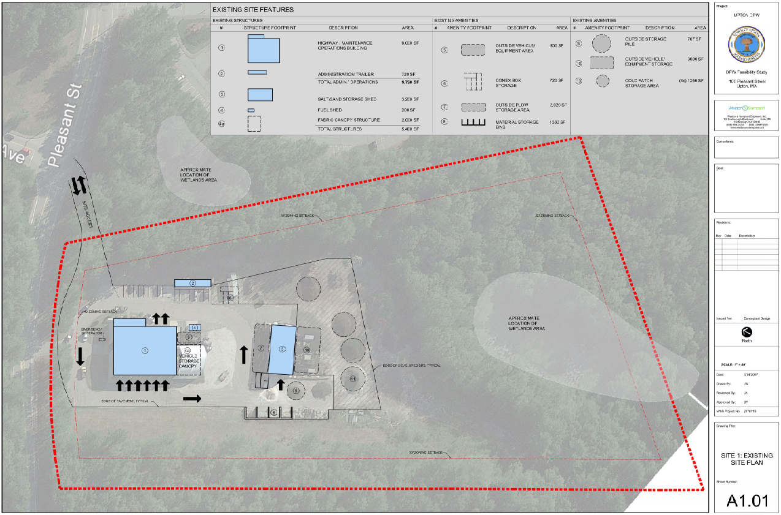
Current Facility DPW Facility

Slide 9
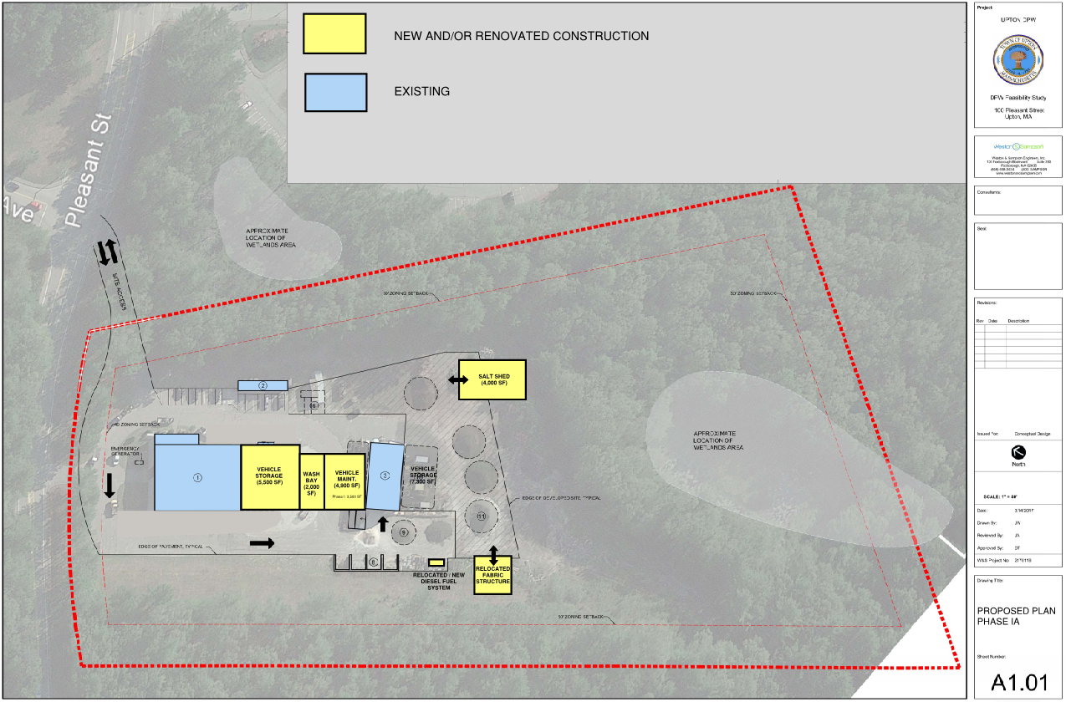
Phase 1A
DPW Facility

Slide 10
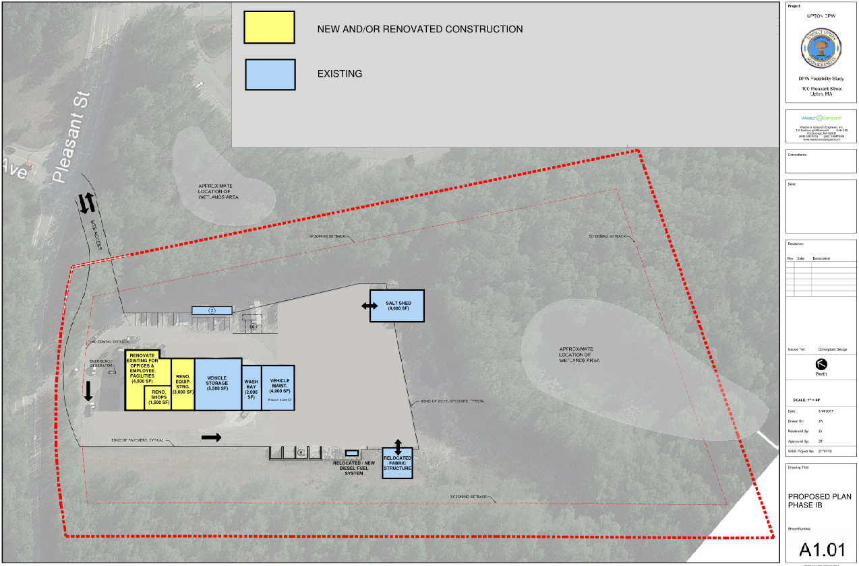
Phase 1B
DPW Facility

Slide 11
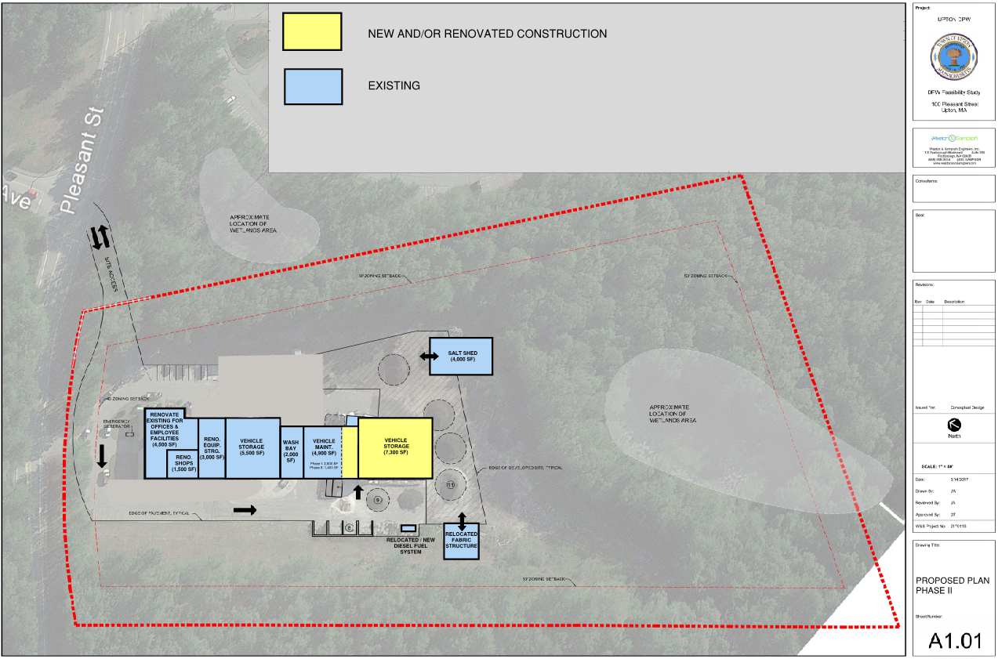
Phase 2 DPW Facility

Slide 12
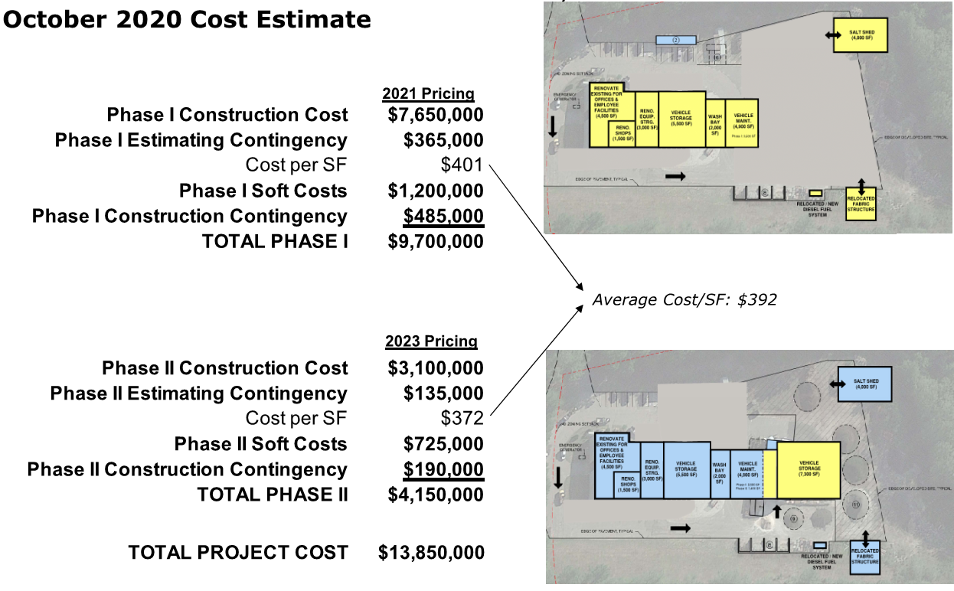
Town of Upton DPW Facility

Slide 13
Next Steps and Recommendations
Committee recommends proceeding with Phase 1 Implementation
Due to pandemic, more competitive bidding climate resulting in savings
Long term borrowing costs are at an all time low
Committee advocates for adding Phase 1 to the Capital Budget cycle (10 yr. horizon)
Committee recommends independent cost estimates
Conceptual cost estimate and a schematic design cost estimate
Will deliver more accurate costs
Firmly believe that lower overall project costs can be achieved

Slide 14
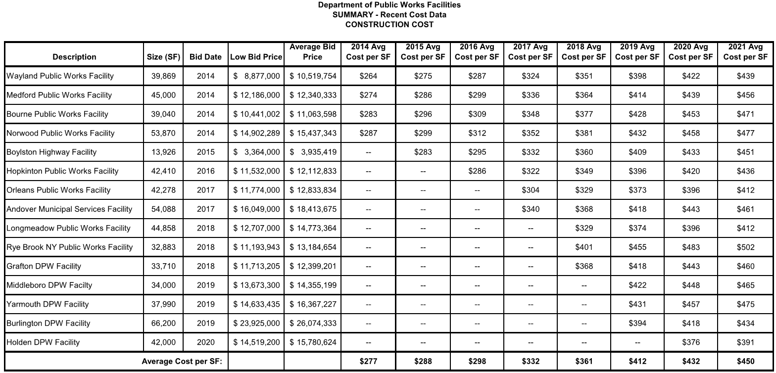
Benchmark Comparison DPW Facility

Slide 15
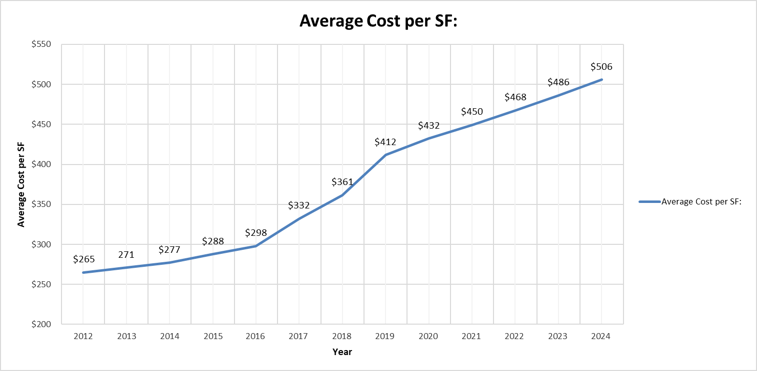
Town of Upton DPW Facility
HISTORIC COST DATA FOR DPW FACILITIES
Cost / SF based on actual DPW Facility Bid Prices
(NEW CONSTRUCTION)
Upton 2021 @ $392/SF
Upton 2018 @ $297/SF
Upton cost/SF is lower than other DPW projects due to the reuse and renovation of the existing 9,000 SF building

Slide 16
Town of Upton DPW Facility
HISTORIC COST DATA FOR DPW FACILITIES
Potential Impacts from the Pandemic Driven Recession
Upton 2021 @ $392/SF
Upton 2018 @ $297/SF

