Slide 1

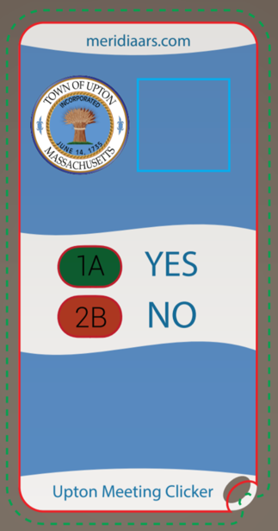
Town Meeting
ELECTRONIC VOTING INSTRUCTIONS

Slide 2
Introduction
This meeting will be interactive - you will be asked to vote using the wireless remote device you were given
Please don’t take the handset with you – it doesn’t work outside of this room
Return the devices to the check in desk on your way out

Slide 3





ELECTRONIC VOTING
Each registered voter has received a (randomly selected) voting device at check in
These devices use reliable radio frequency and are secure NO INTERNET IS USED
If you leave the room for any reason, return your voting device to the check in staff, and it will be handed back to you on your return
At the conclusion of Town Meeting, all voting devices will be collected. Please do not leave with the voting devices

Slide 4
How to vote
The Moderator will declare Open Vote for each article
During Open Vote, press the button on the keypad that matches your desired vote:
1A = YES
2B = NO
Vote will be submitted automatically and confirmed by showing “OK” on the device display after each vote
You may change your vote but you can’t clear it – ONLY YOUR LAST VOTE COUNTS

Slide 5
When is the vote counted
The Moderator will declare Close of Voting for each article
Recorded results will appear on the large presentation screen
The Moderator will move to the next article

Slide 6
Testing The handsets
Test question 1 – all voters please cast a YES vote
Test question 2 – all voters please cast a NO vote
Test question 3 – voters may cast either YES or NO

