Slide 1
Upton’s Ecosystem

Slide 2
"It's surely our responsibility to do everything within our power to create a planet that provides a home not just for us, but for all life on Earth."
--- Sir David Attenborough

Slide 3
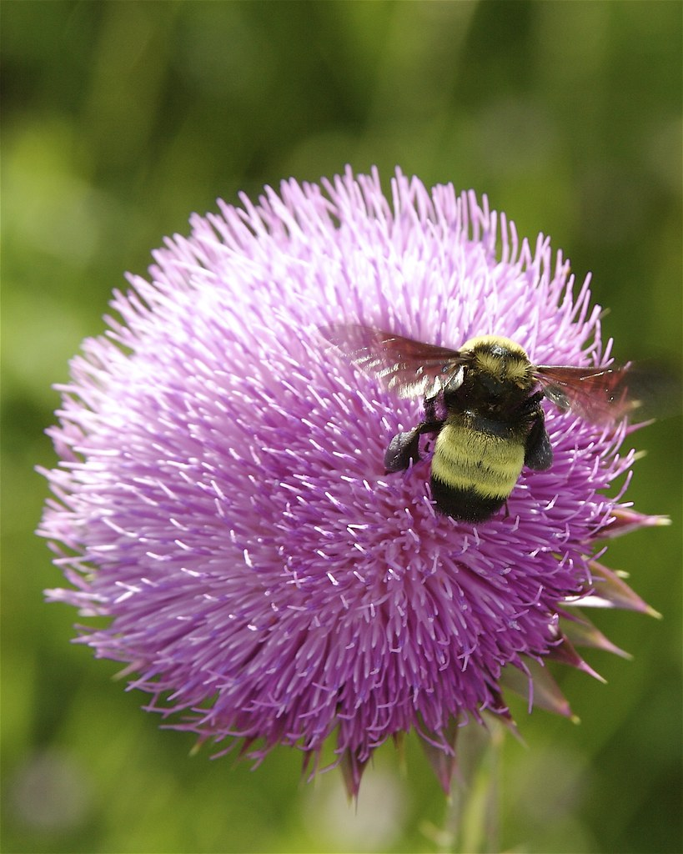
American Bumblebee
This Photo by Unknown Author is licensed under CC BY-NC-ND

Slide 4
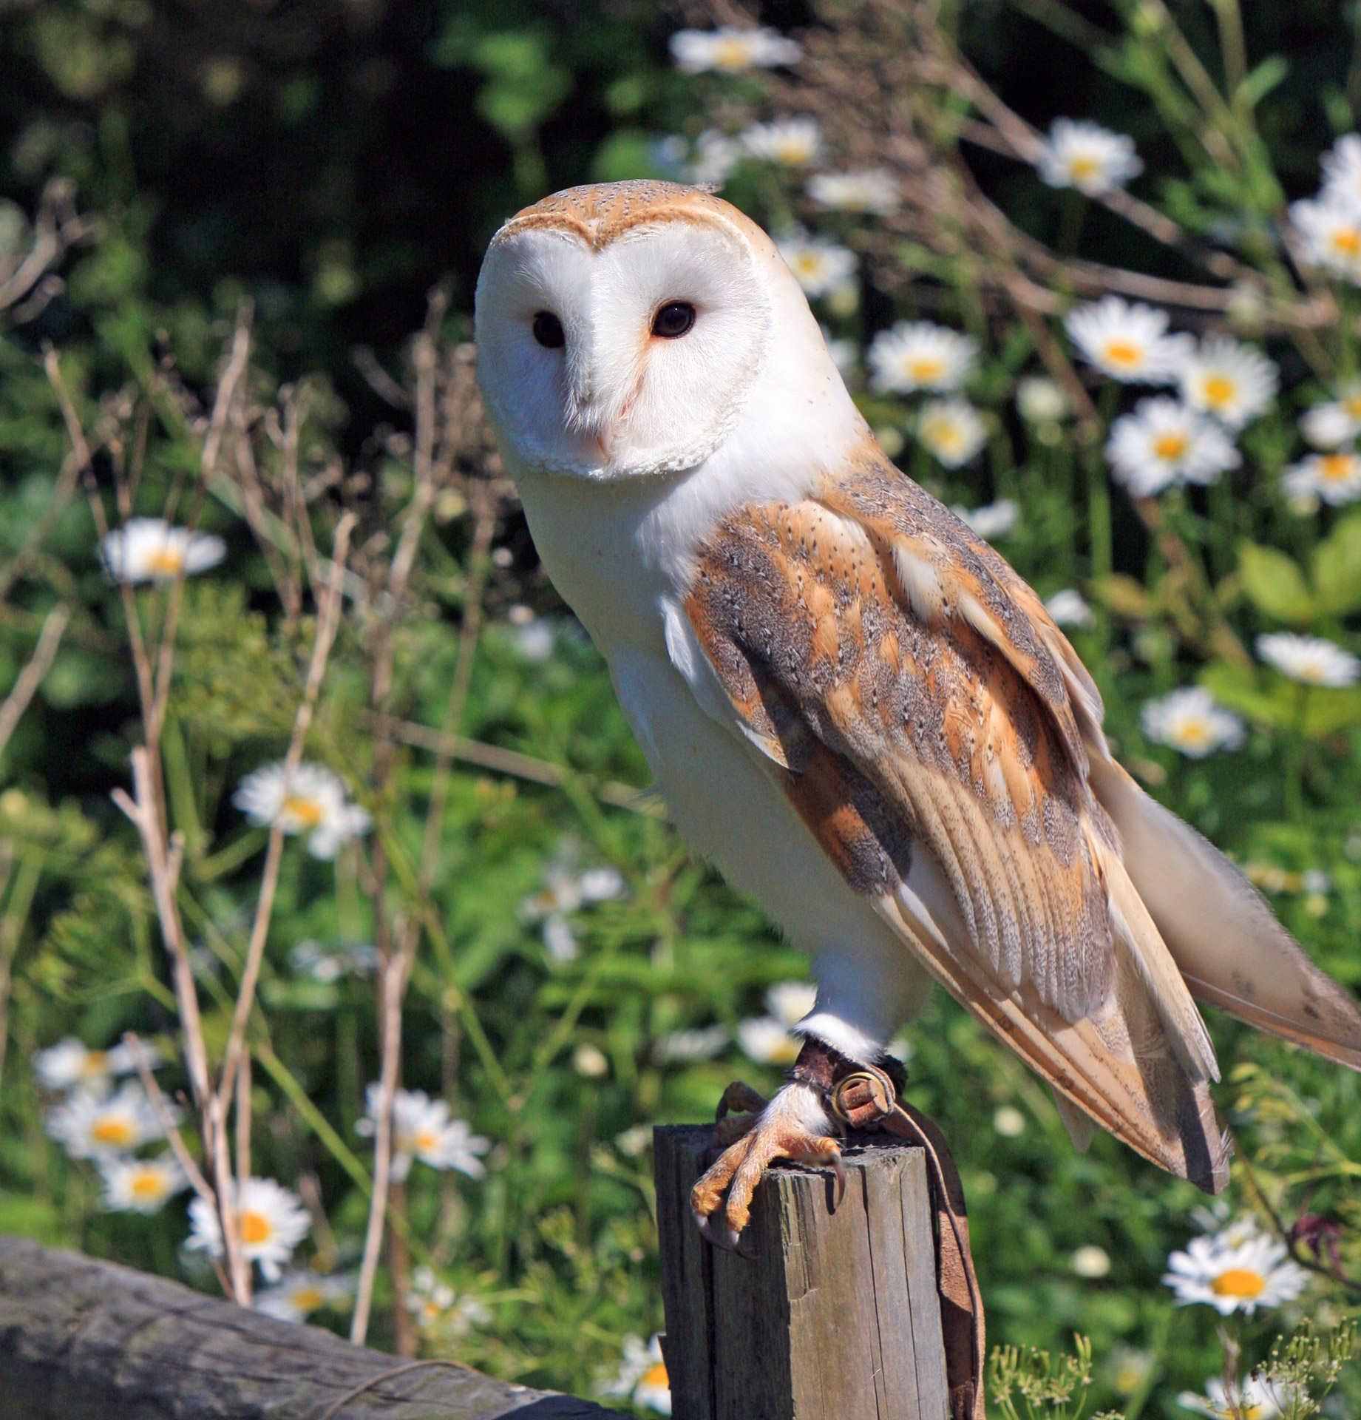
Barn Owl

Slide 5
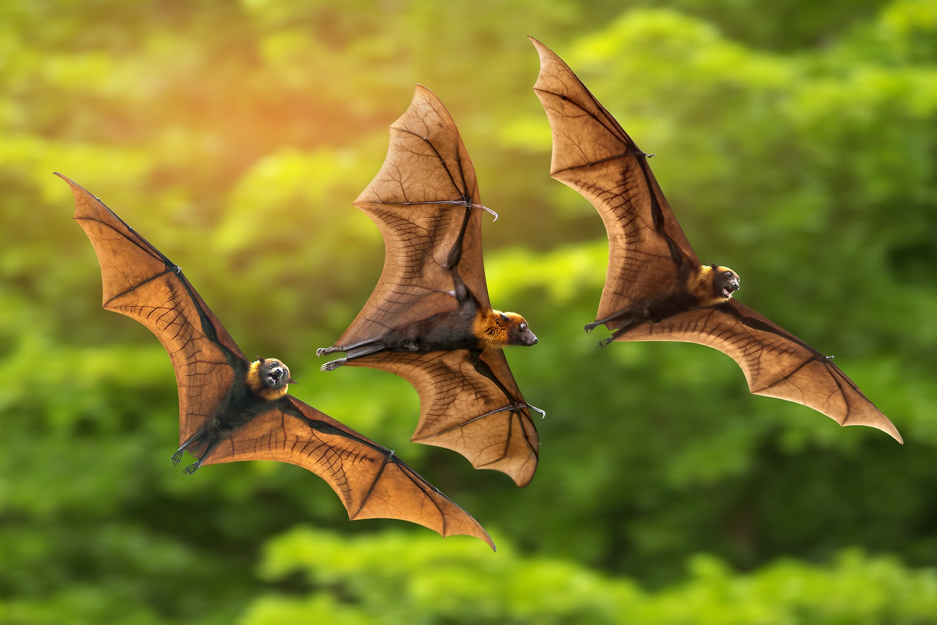
Bats

Slide 6
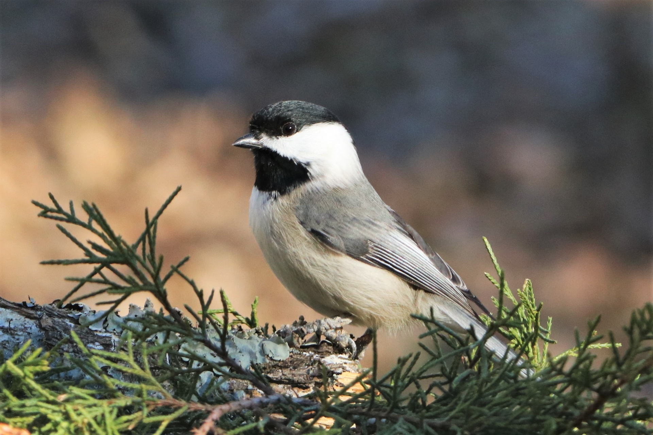
Chickadee

Slide 7
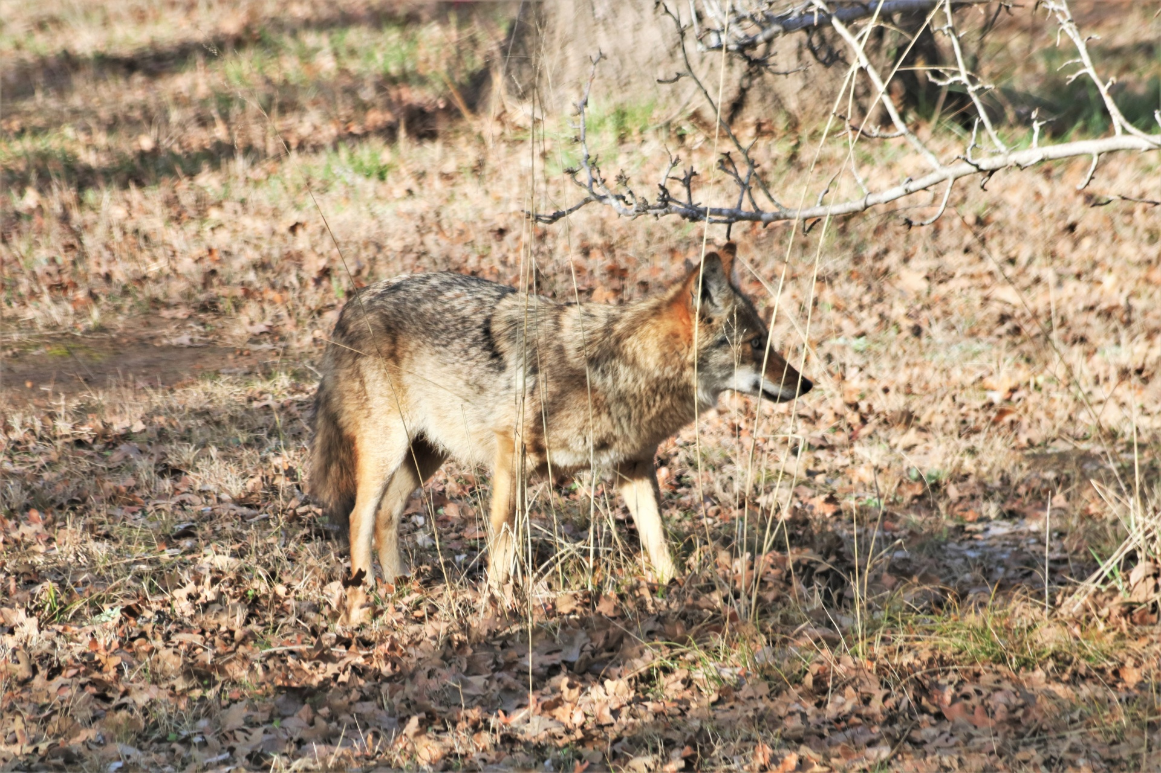
Coyote

Slide 8
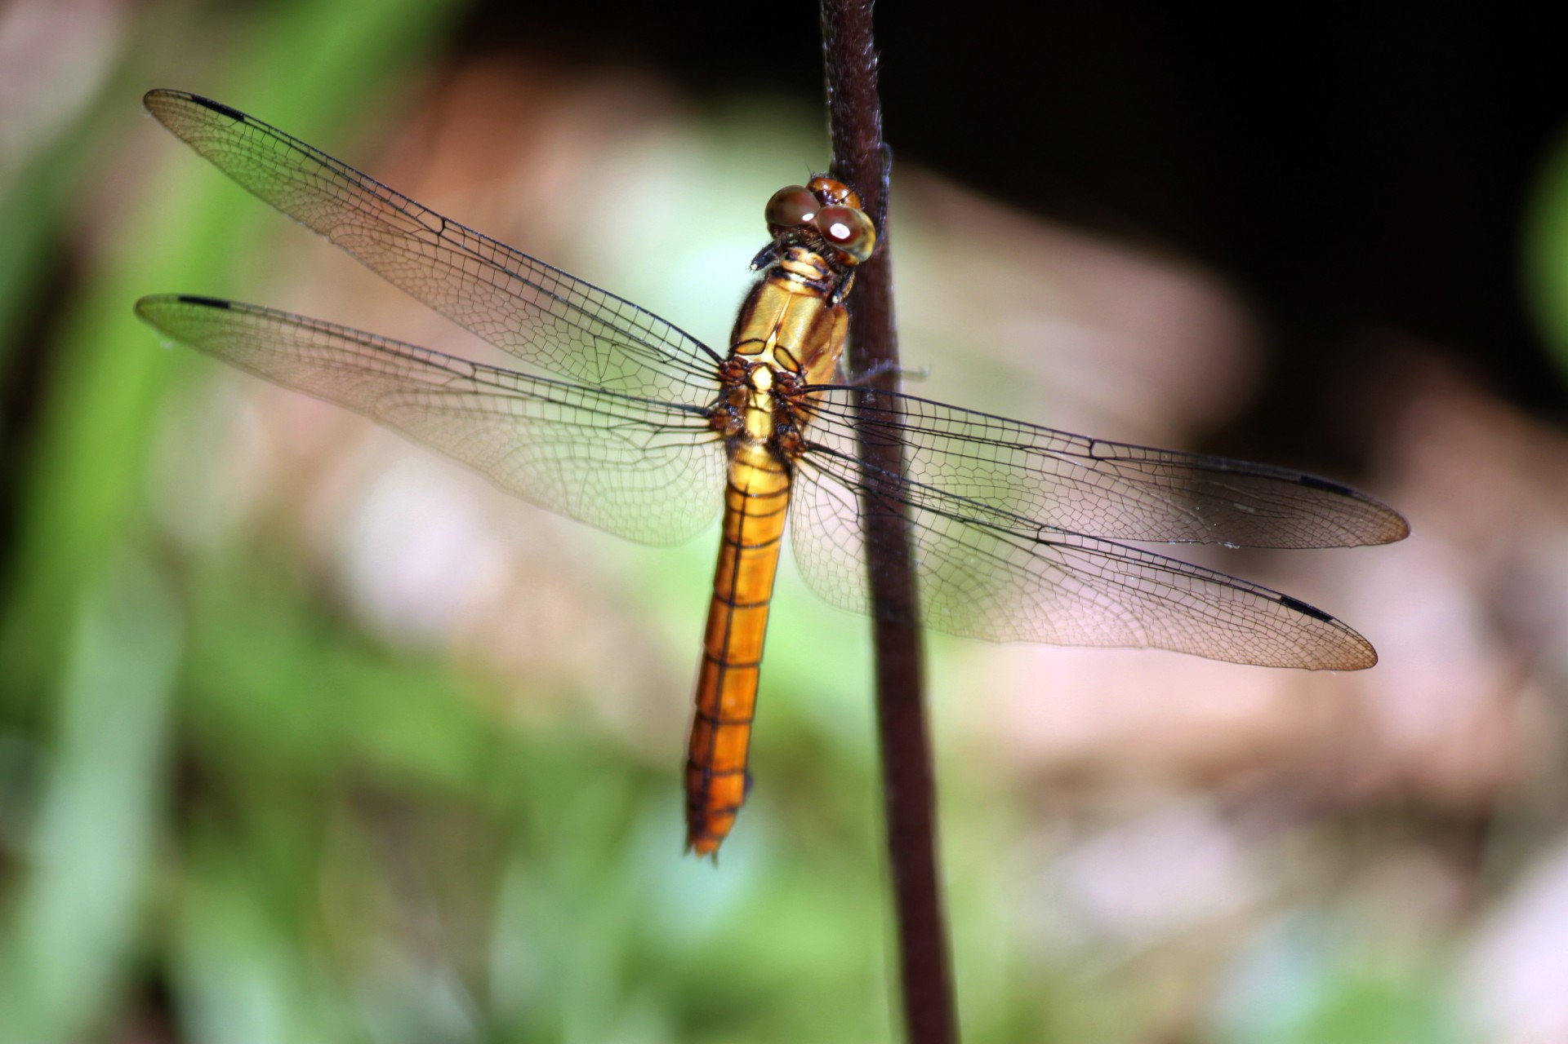
Dragonfly

Slide 9
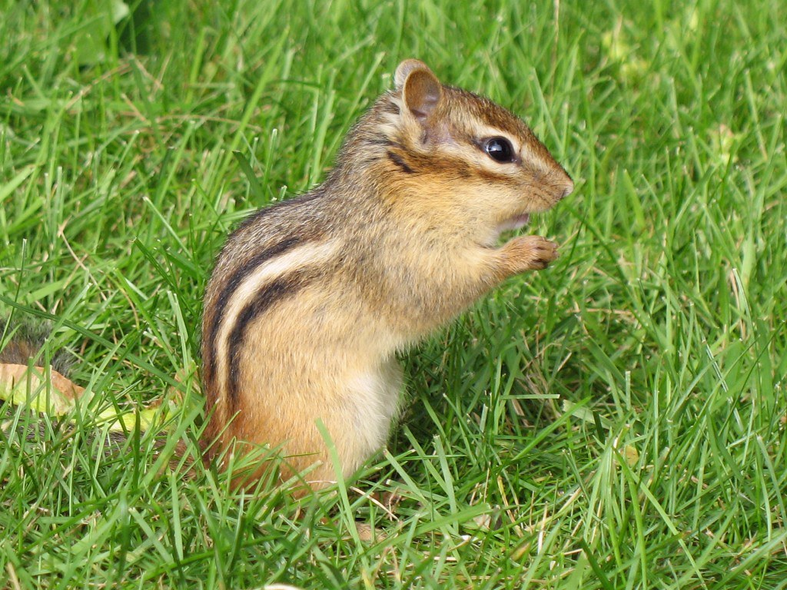
Eastern Chipmuck
This Photo by Unknown Author is licensed under CC BY

Slide 10
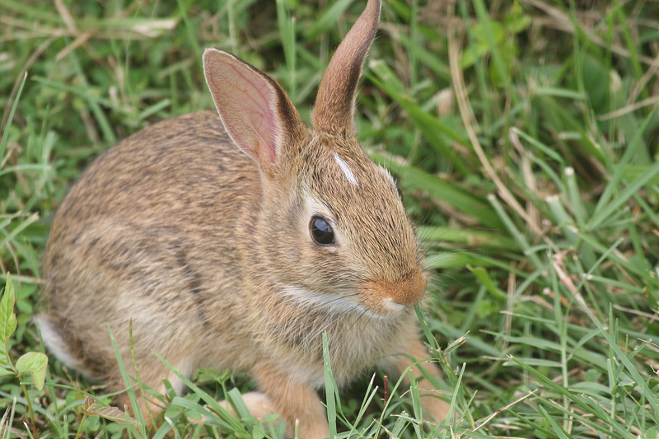
Eastern Cottontail
This Photo by Unknown Author is licensed under CC BY-NC

Slide 11
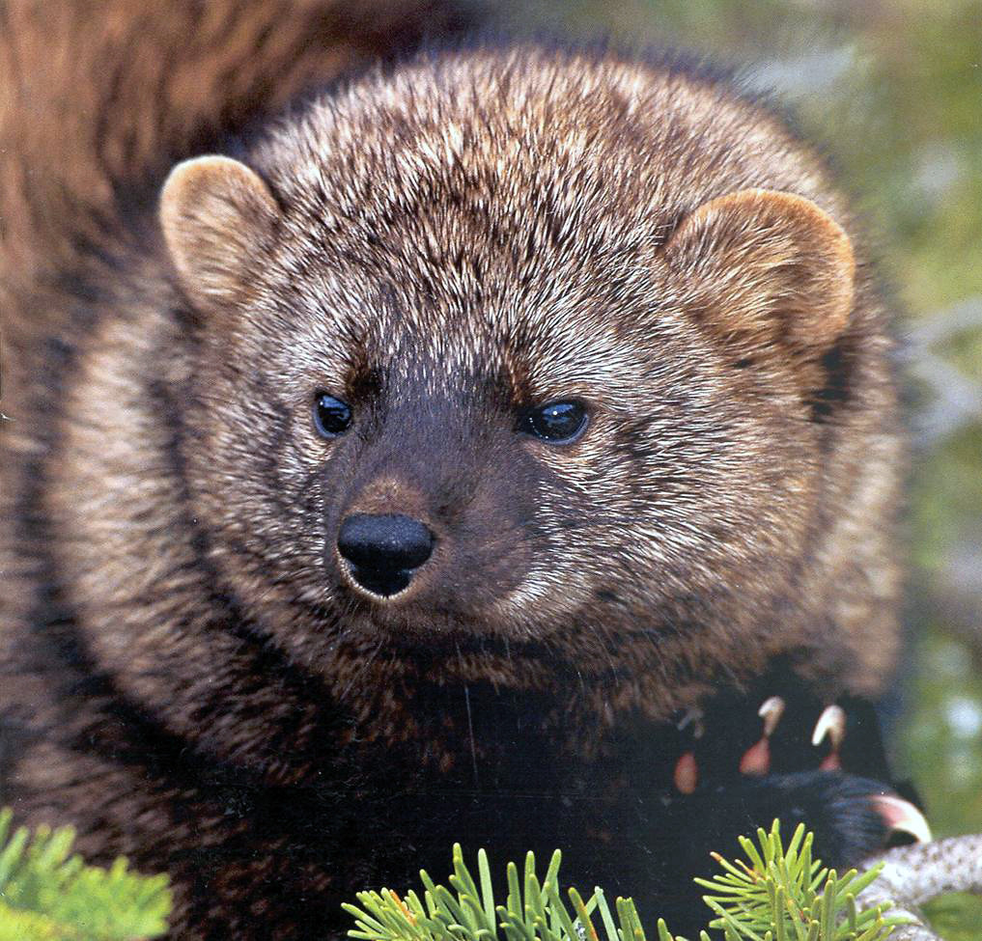
Fisher Cat
This Photo by Unknown Author is licensed under CC BY

Slide 12
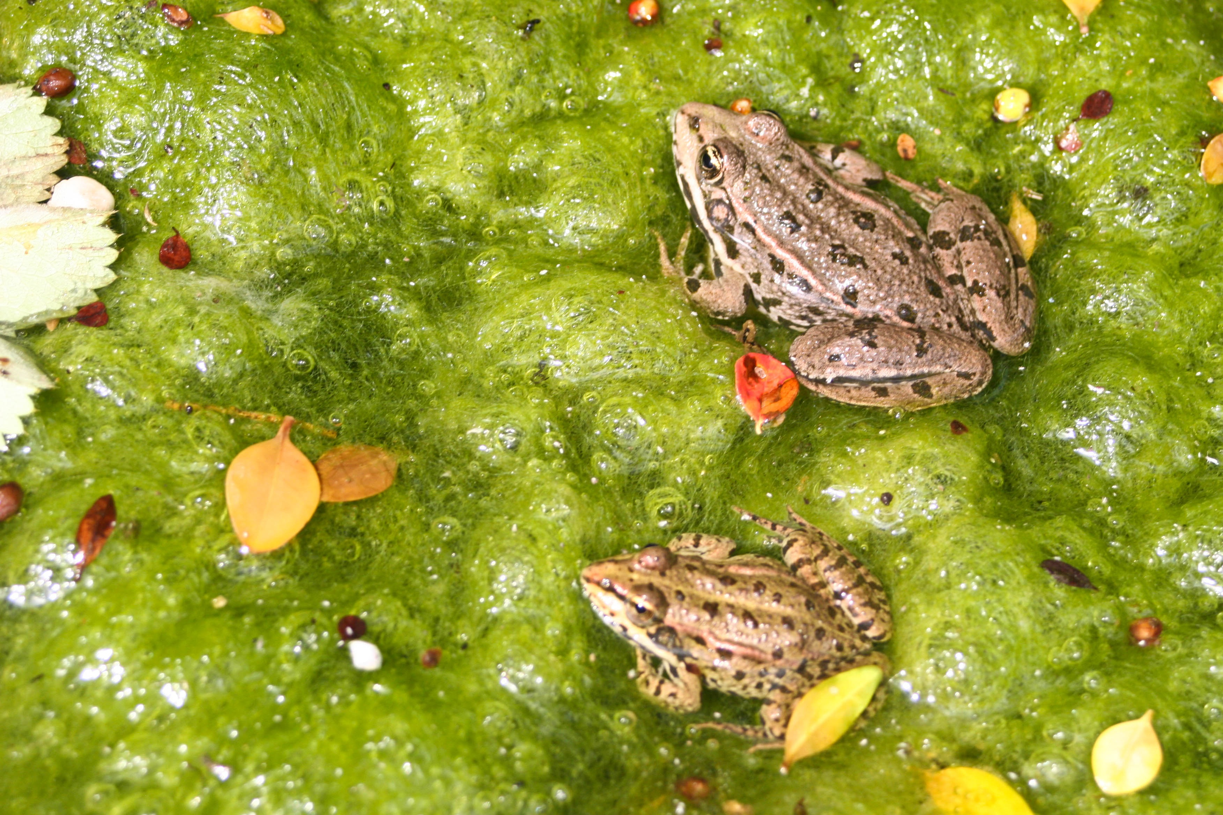
Frogs

Slide 13
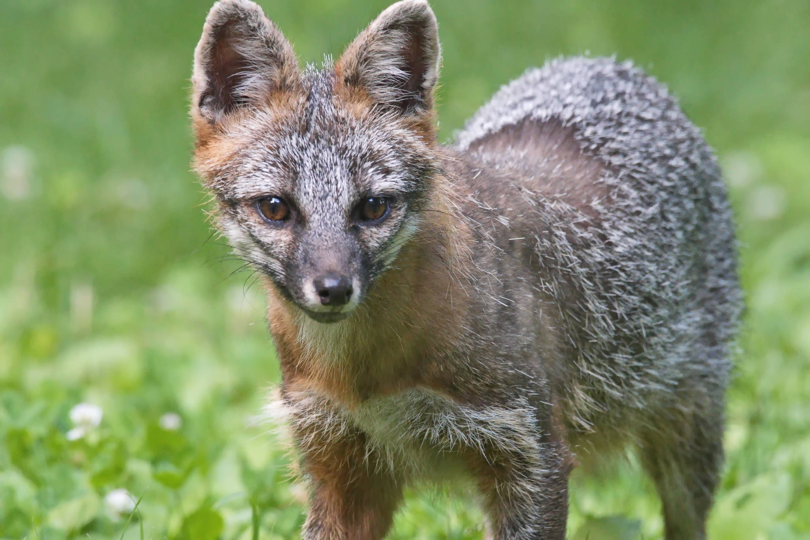
Gray Fox
This Photo by Unknown Author is licensed under CC BY-NC

Slide 14
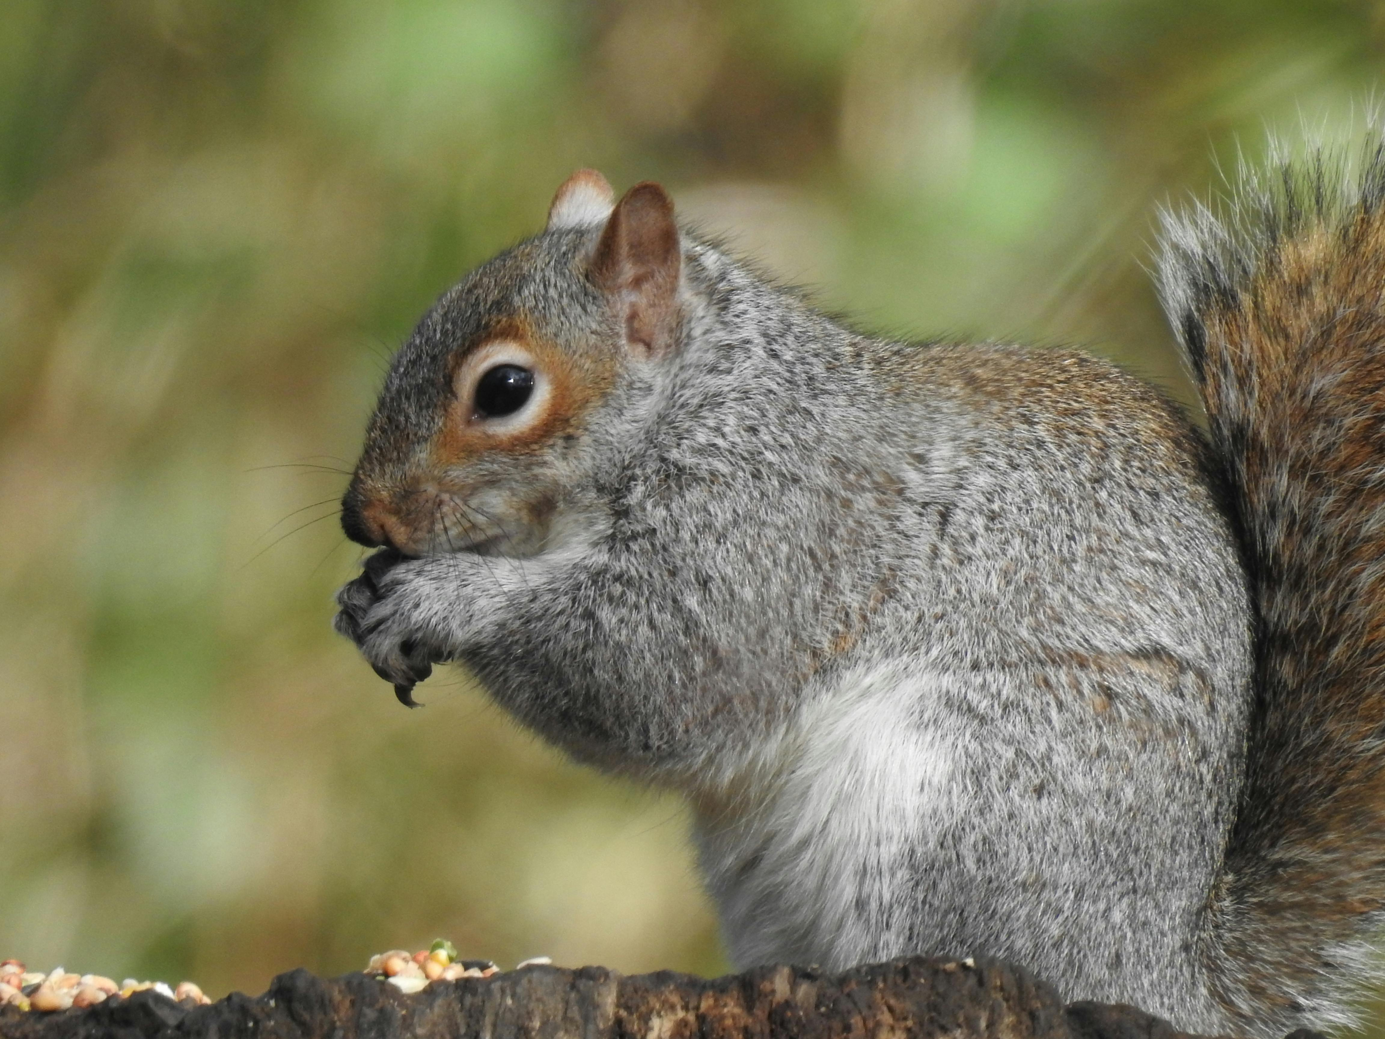
Gray Squirrel

Slide 15
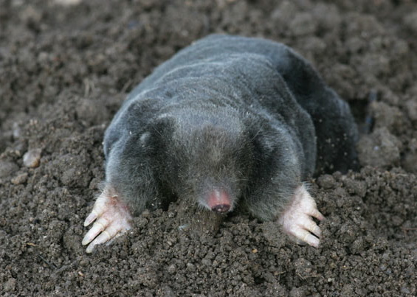
Mole

Slide 16
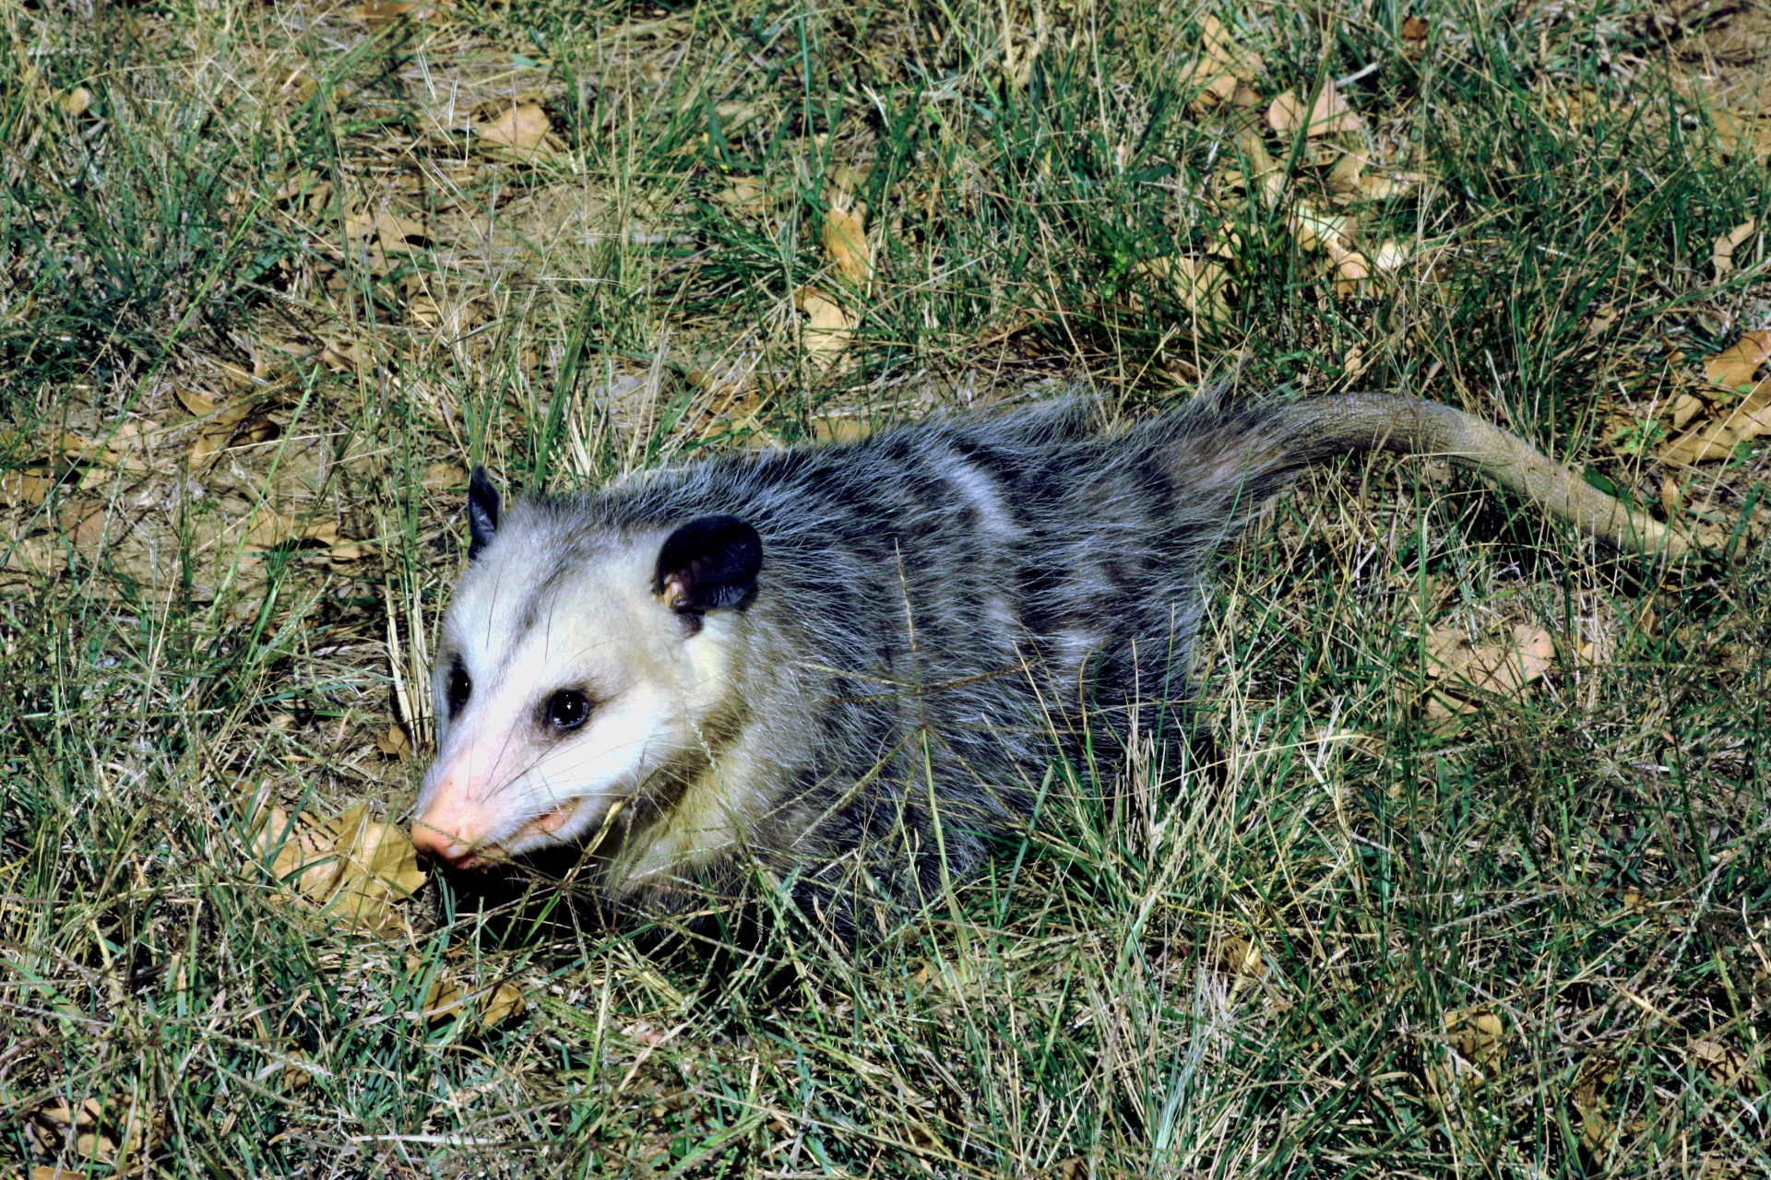
Opossum
This Photo by Unknown Author is licensed under CC BY-SA-NC

Slide 17
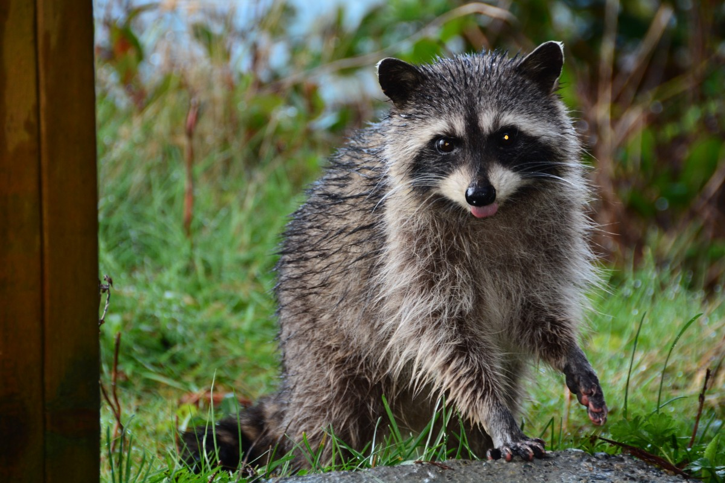
Raccoon

Slide 18
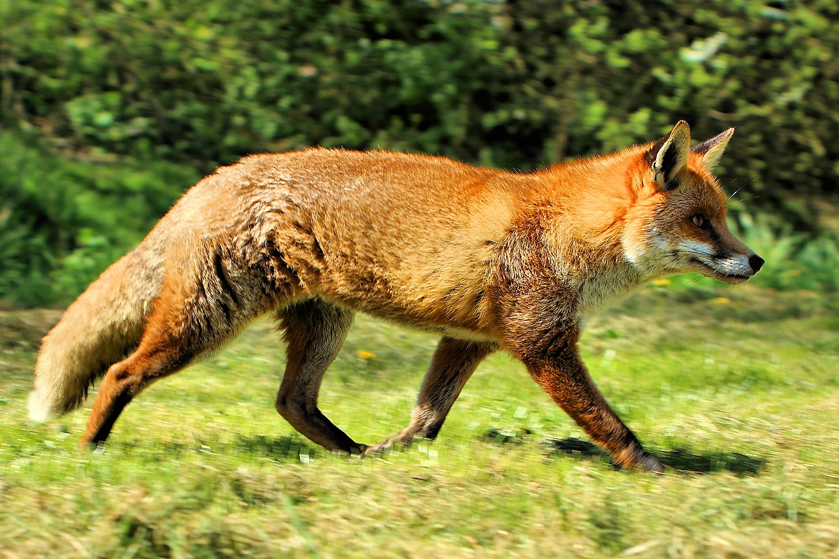
Red Fox
This Photo by Unknown Author is licensed under CC BY-SA

Slide 19
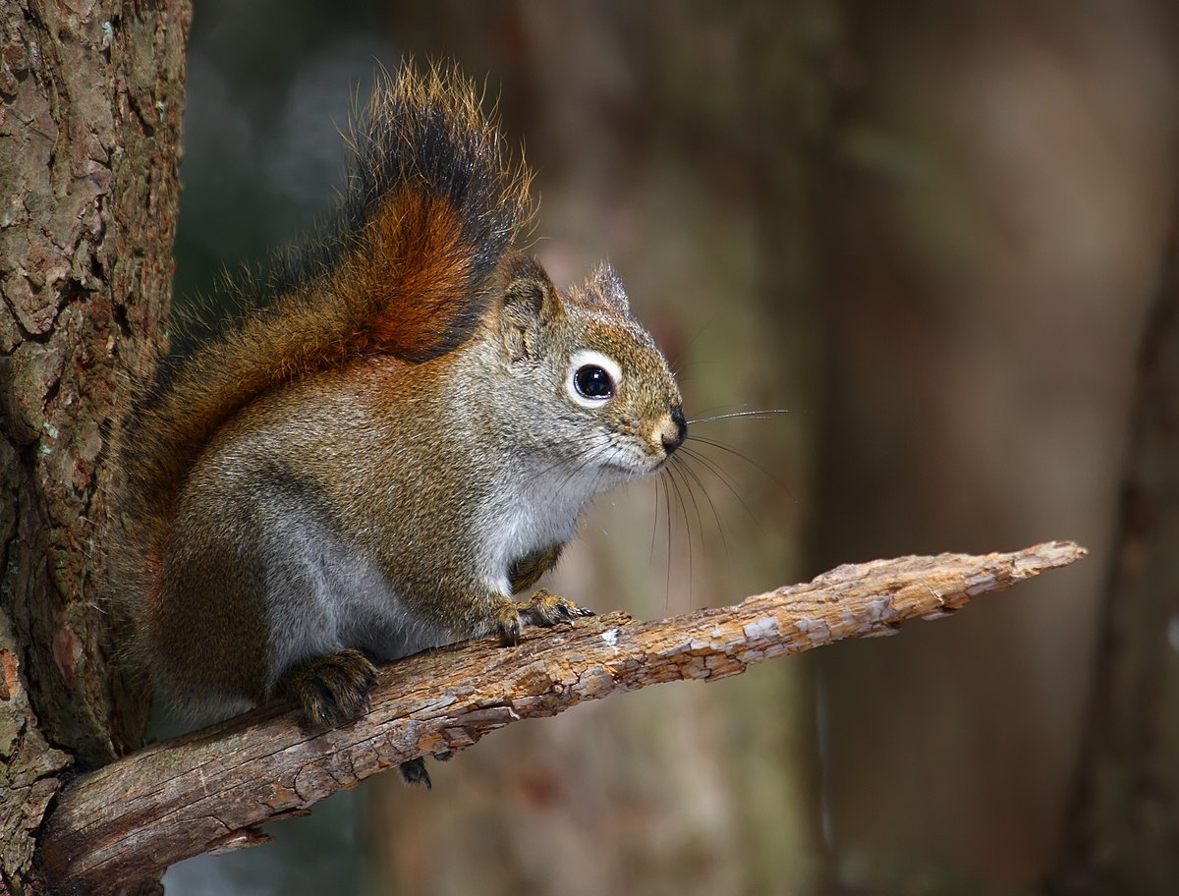
Red Squirrel
This Photo by Unknown Author is licensed under CC BY-SA

Slide 20
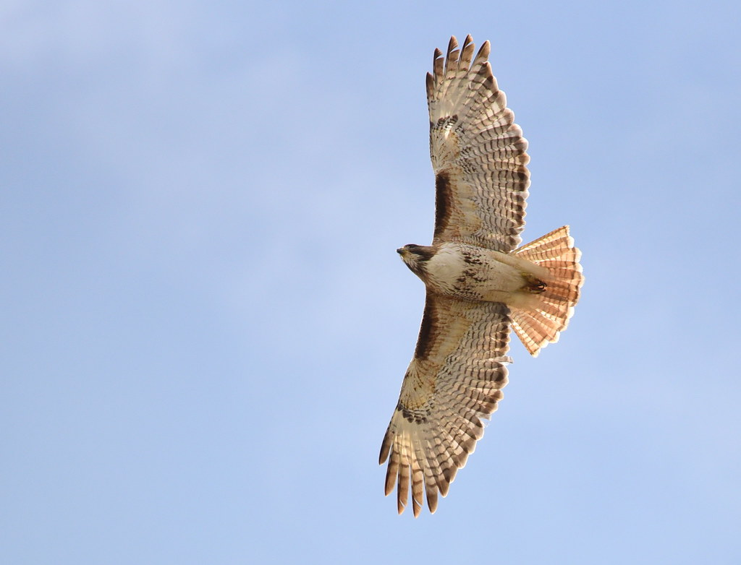
Red-Tailed Hawk
This Photo by Unknown Author is licensed under CC BY

Slide 21
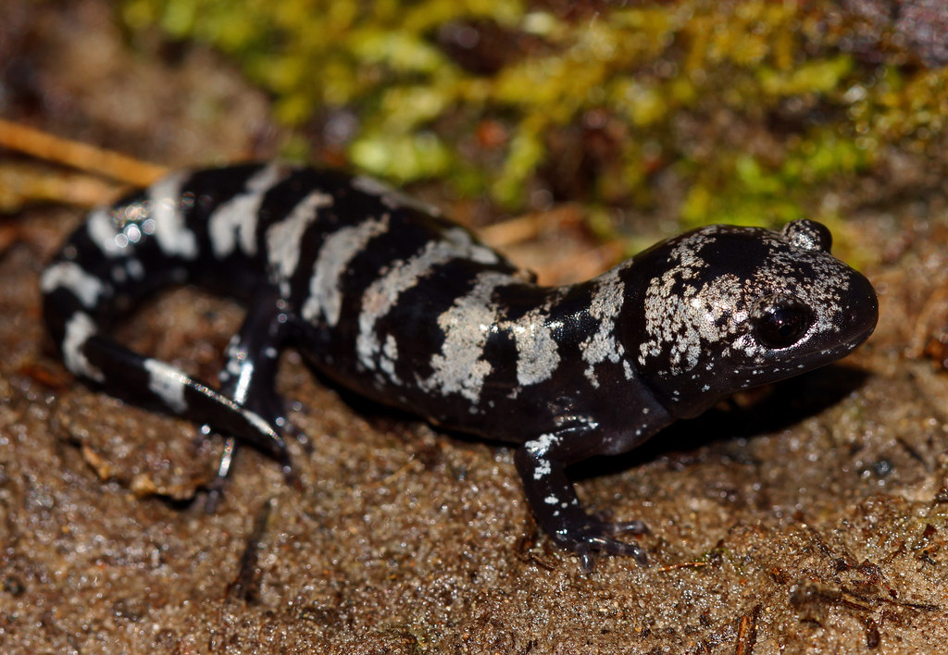
Salamander
This Photo by Unknown Author is licensed under CC BY

Slide 22
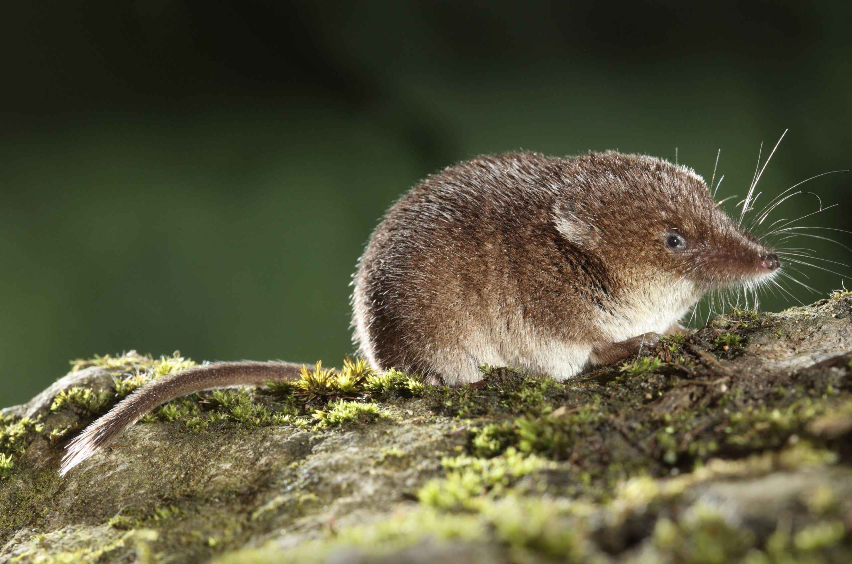
Shrew

Slide 23
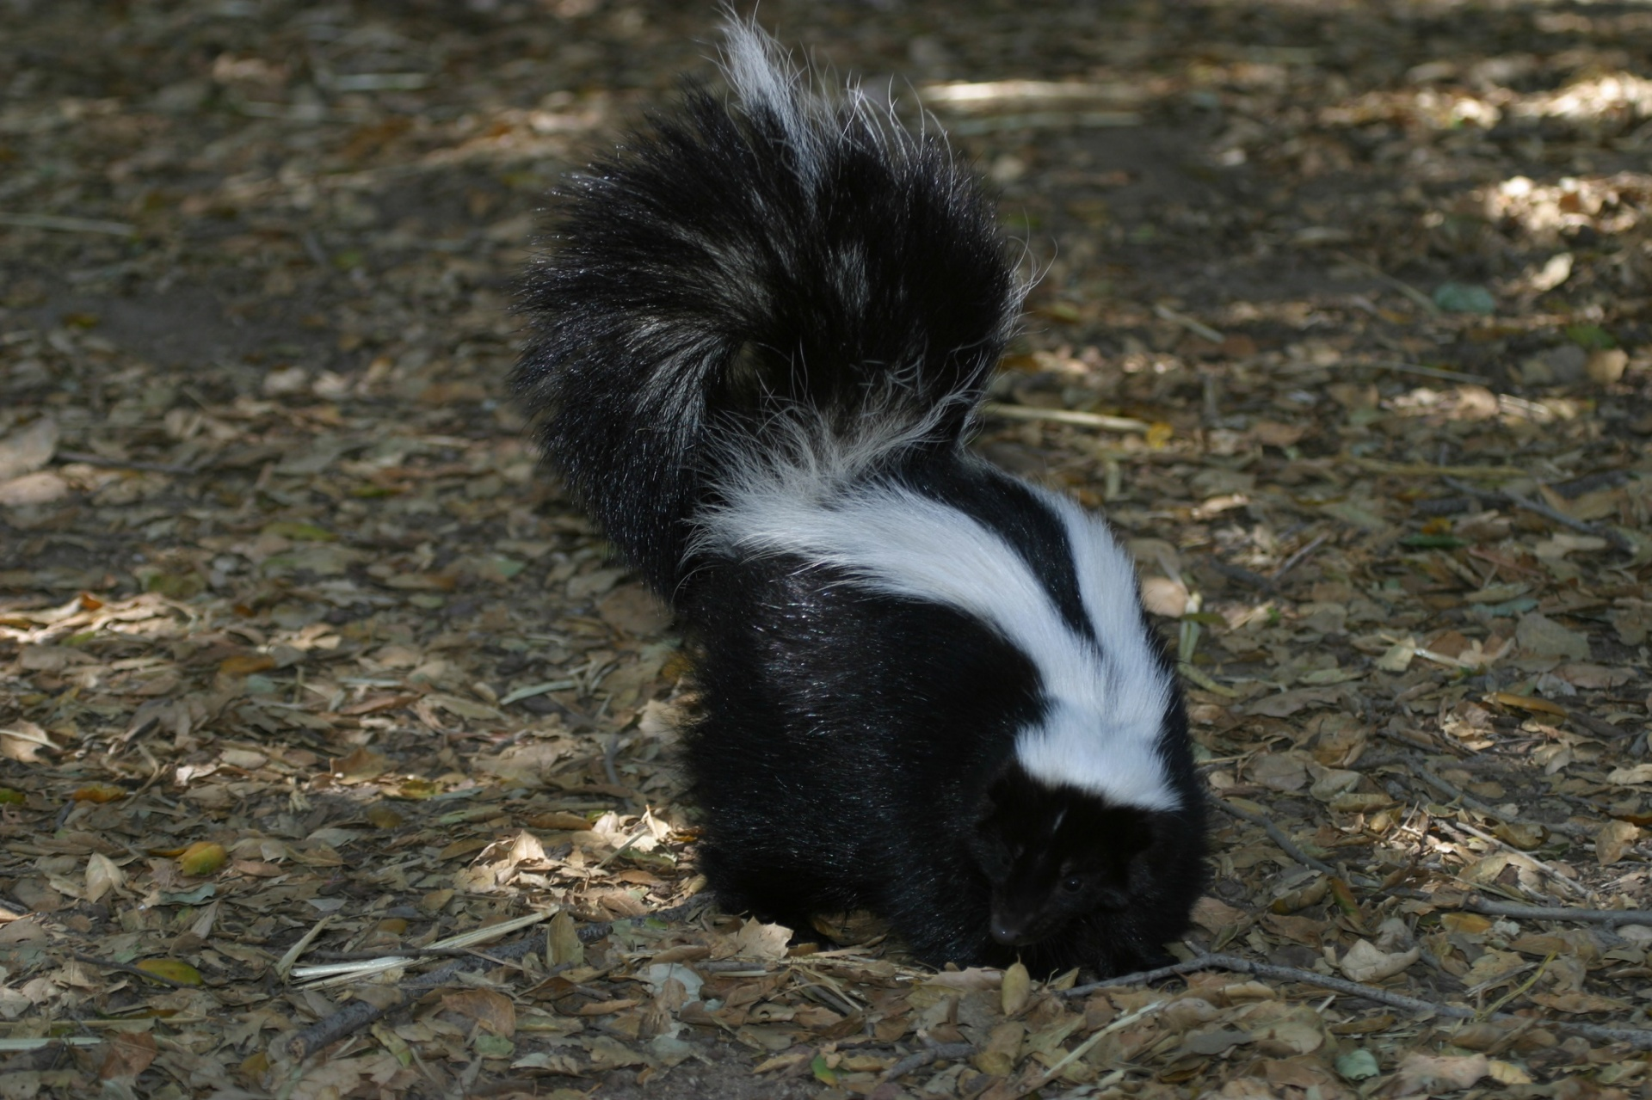
Skunk

Slide 24
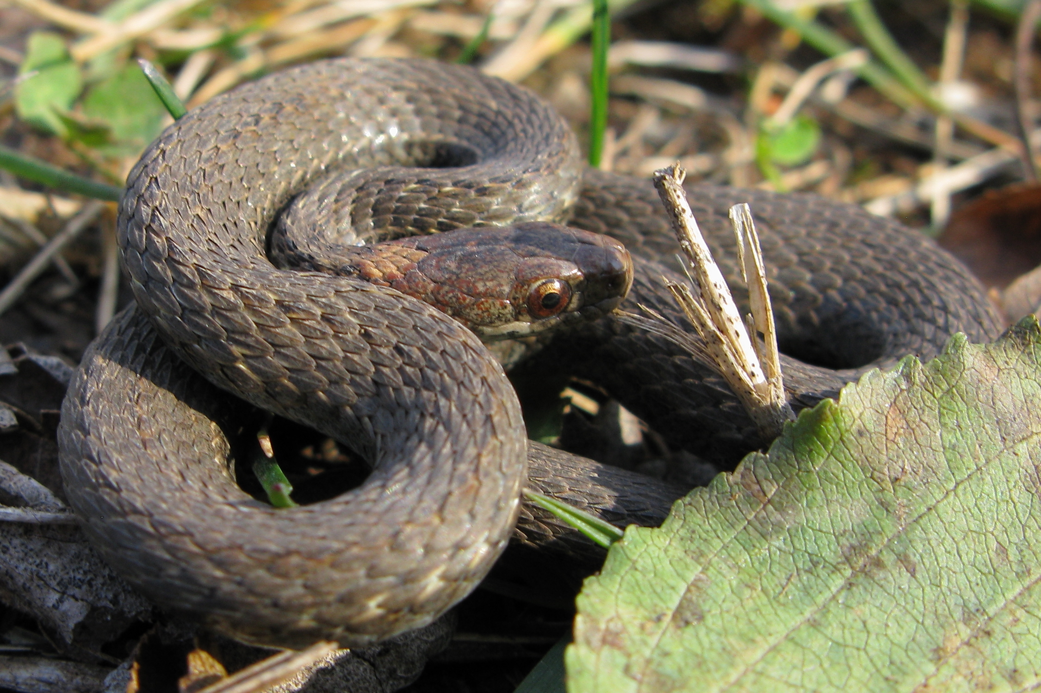
Snakes
This Photo by Unknown Author is licensed under CC BY-SA

Slide 25
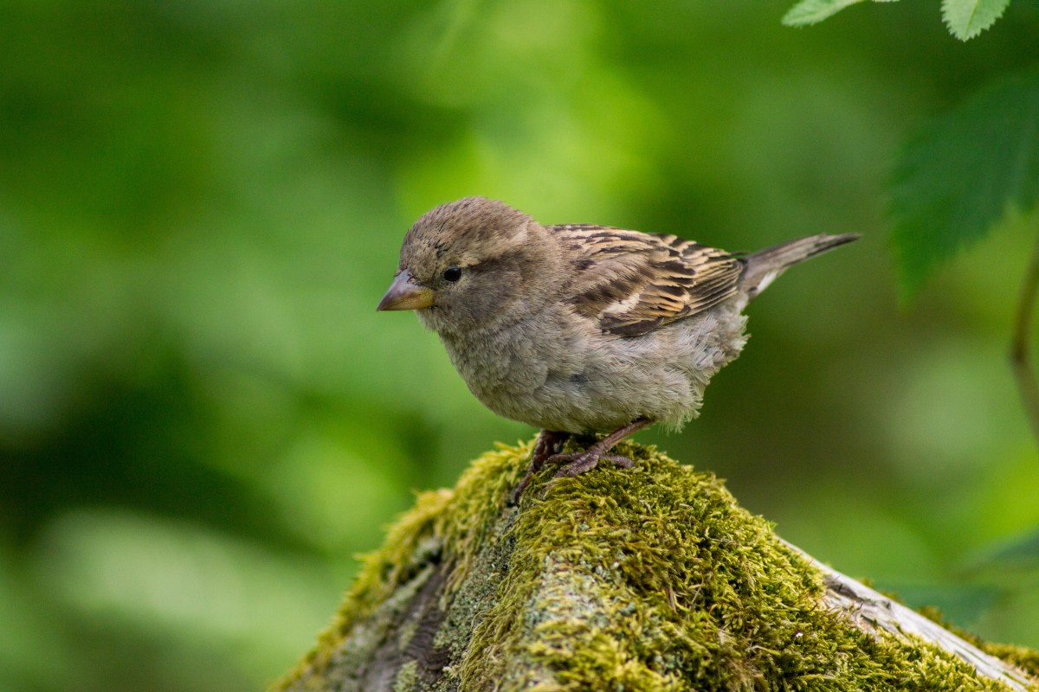
Sparrow

Slide 26
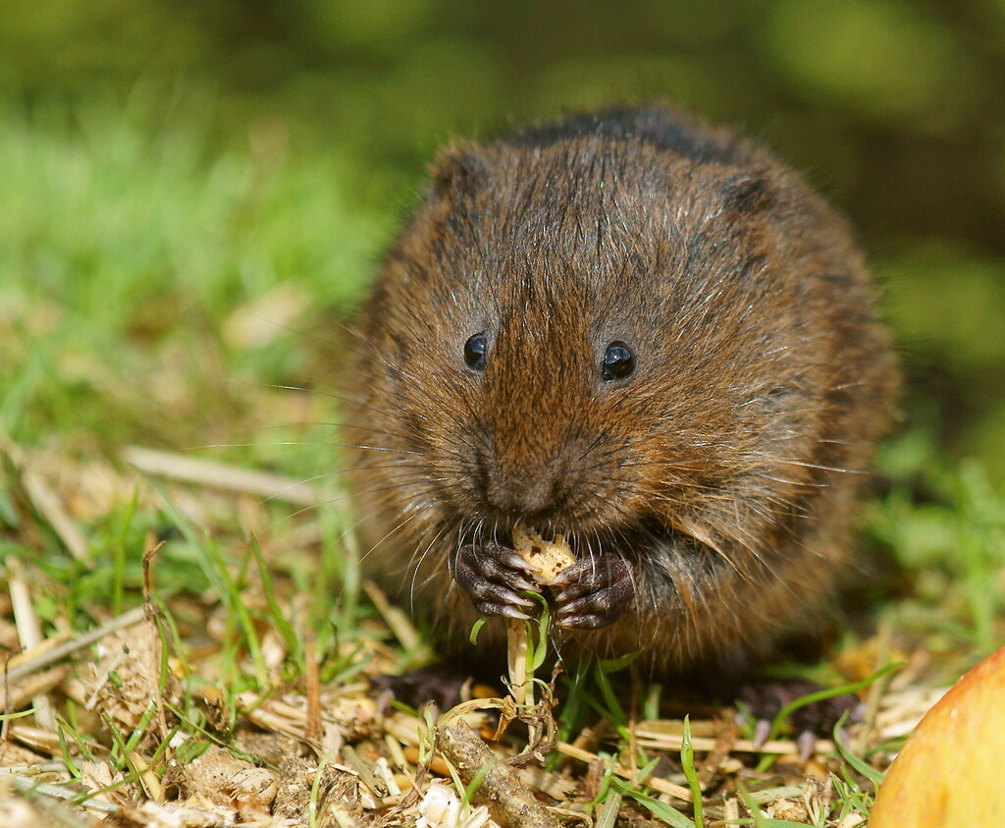
Vole
This Photo by Unknown Author is licensed under CC BY

Slide 27
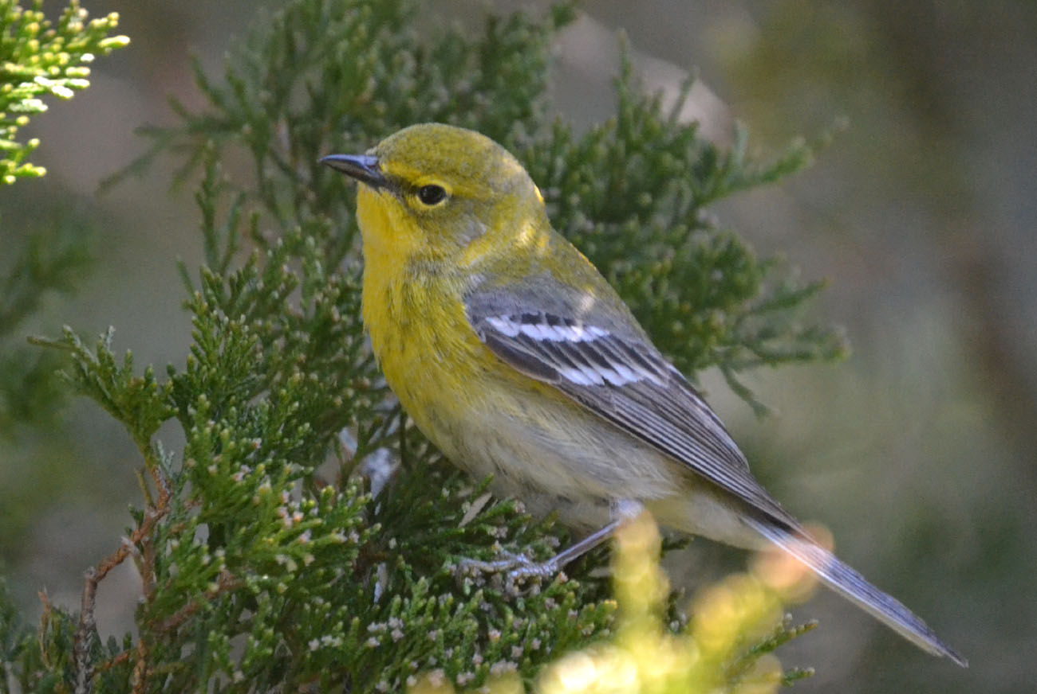
Warbler
This Photo by Unknown Author is licensed under CC BY-SA-NC

Slide 28
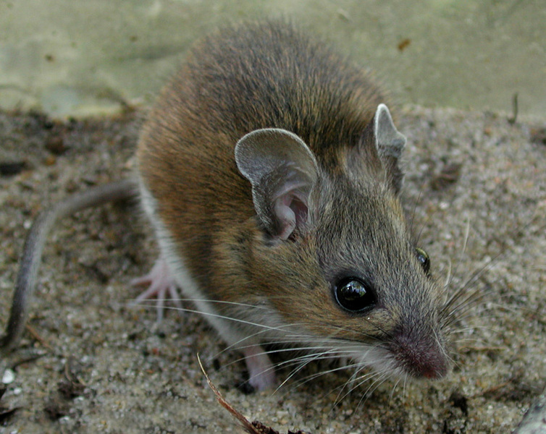
White-Footed Mouse
This Photo by Unknown Author is licensed under CC BY-SA-NC

Slide 29
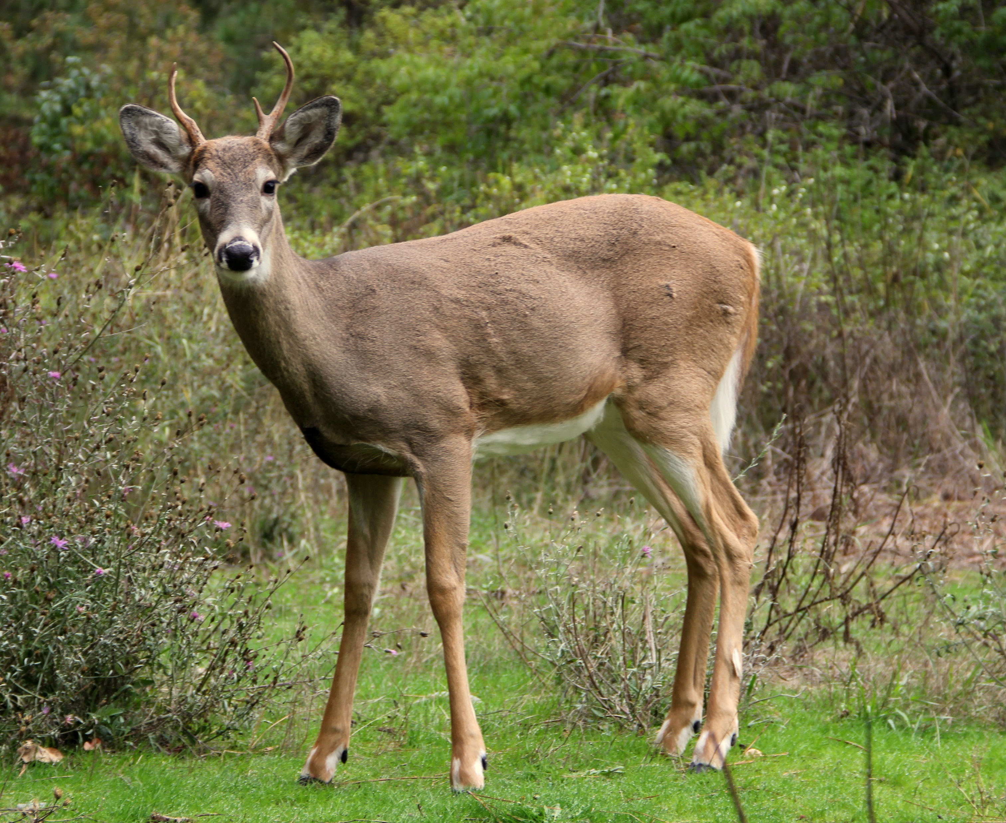
White-Tailed Deer
This Photo by Unknown Author is licensed under CC BY-SA

Slide 30
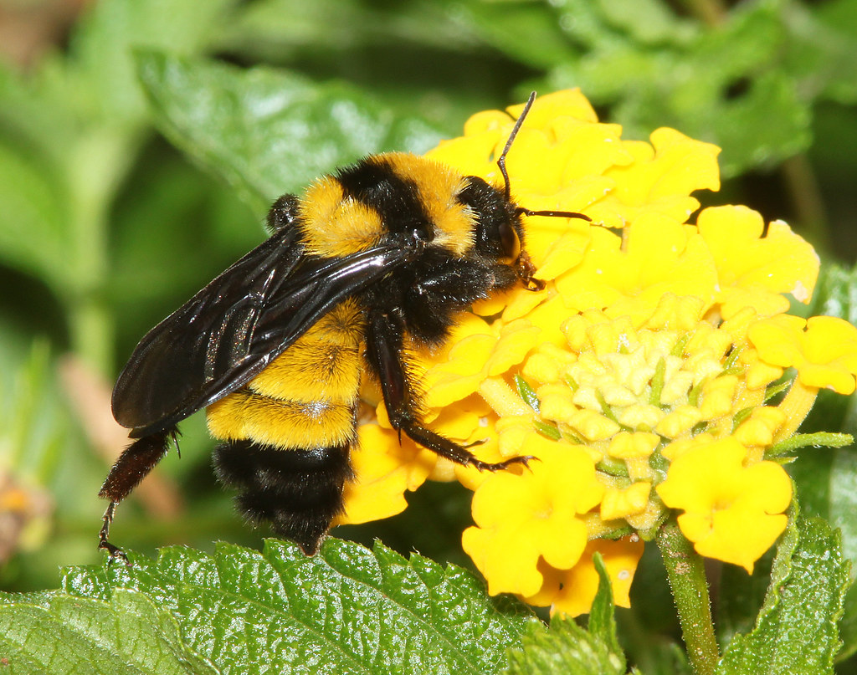
Yellow Banded Bumblebee

Slide 31
Source: MassWildlife's Natural Heritage & Endangered Species Program Rare Species Viewer. https://www.mass.gov/info-details/rare-species-viewer.

Slide 32
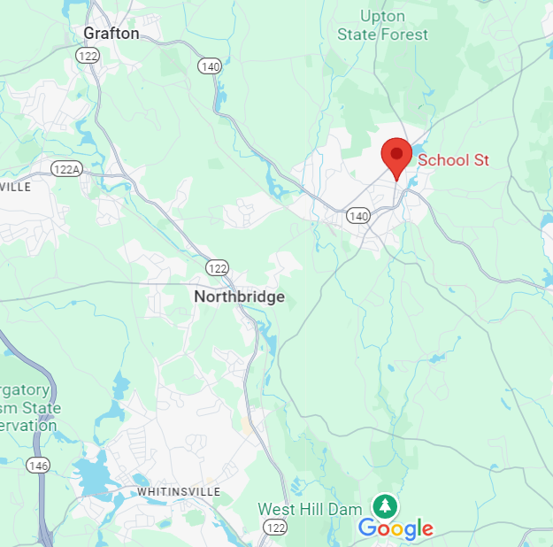
Upton is 21.74 mi² or 13,913.6 acres. What happens to the ecosystem?

